Slide 1

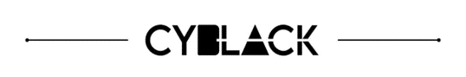
Threat Intelligence Analysis
StealBit Malware
SOC Group 3 • September 2025

Slide 2


The Evolving Ransomware Threat
Double Extortion Reality
Data theft before encryption
Pay ransom or face public leaks
StealBit enables LockBit campaigns
Modern ransomware isn't just about encryption anymore—it's about maximum leverage

Slide 3

Executive Summary
Detection
1 malicious file identified from 31 hashes
Threat
StealBit data exfiltration tool
Actor
LockBit ransomware group
Impact
Double extortion attacks

Slide 4
Analysis Objectives
01
02
Detect Malicious Samples
Identify Threat Actors
Identify threats in dataset
Research malware family origins
03
04
Analyze Attack Methods
Recommend Defenses
Understand business risks
Practical strategies for management

Slide 5




Investigation Methodology
Hash Analysis
Python + VirusTotal API scan
1 malicious hit: StealBit
Threat Research
StealBit capabilities & LockBit attribution
Global impact assessment
Detection Development
Custom YARA rule creation
Future monitoring capability
Intelligence Reporting
Structured threat intelligence deliverable

Slide 6

StealBit Malware Identified
Threat Category
Infostealer / Data exfiltration tool
Malicious Hash
SHA-256: 107d9fce05ff8296d0417a5a830d180cd46aa120ced8360df3ebfd15cb550636

Slide 7





Attack Chain
Initial Access
Phishing or vulnerabilities
Data Theft
Steals credentials & files
Exfiltration
Sends to attacker servers
Encryption
Ransomware deployment

Slide 8
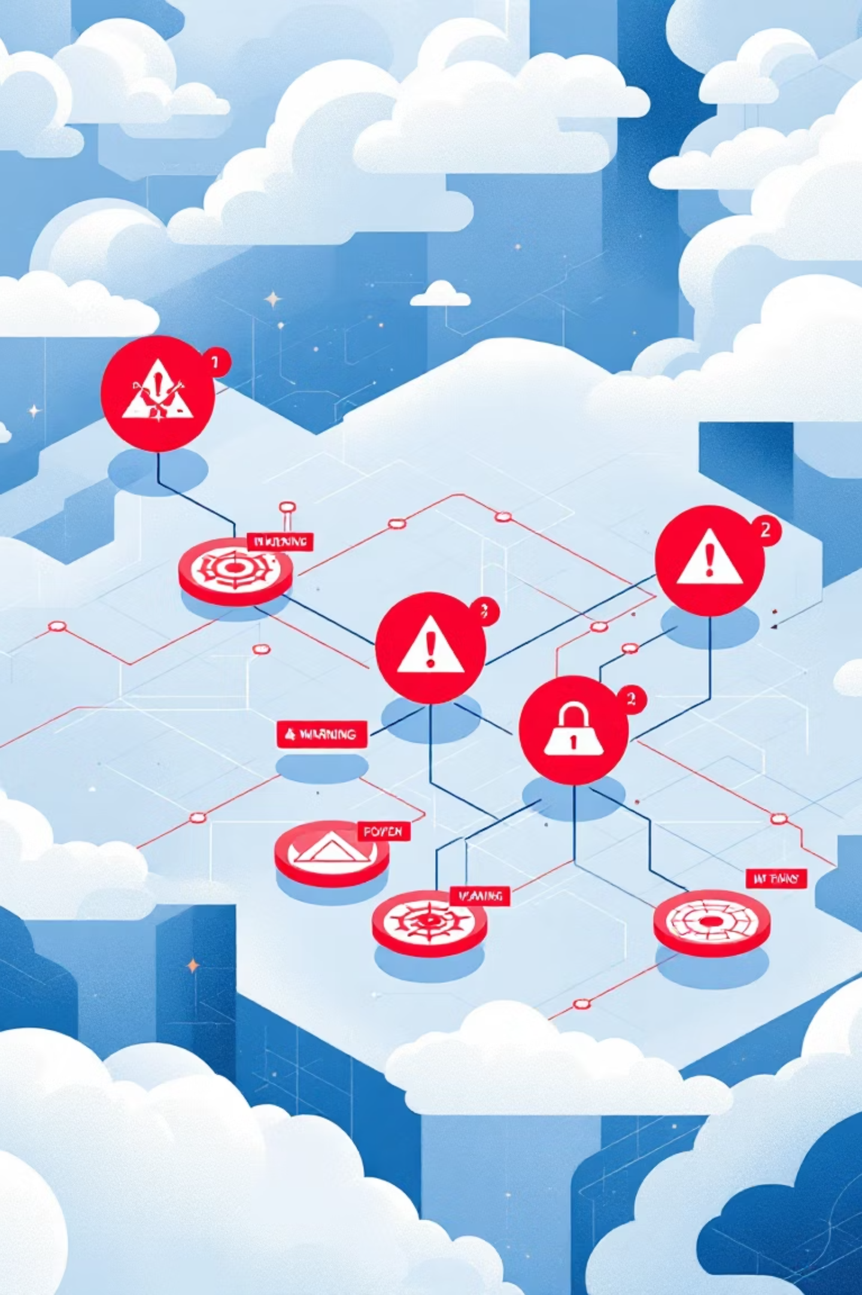
High Risk Vulnerabilities
Weak Phishing Defenses
Easy initial access for attackers
Limited Endpoint Visibility
Undetected lateral movement
Poor Network Segmentation
Rapid threat propagation
Vulnerable Backup Systems
Higher recovery costs

Slide 9

Strategic Defense Roadmap
1
Immediate (0–30 days)
Enhanced phishing defenses
Staff security awareness training
Endpoint detection & response (EDR) strengthening
2
Short-term (30–90 days)
Network segmentation implementation
Backup system testing & hardening
Incident response plan updates
3
Long-term (90+ days)
Zero Trust security model transition
Advanced threat hunting capabilities
Continuous security posture improvement

Slide 10

Key Takeaways
Threat Confirmed
Defense Strategy
StealBit enables modern ransomware attacks
Layered protection with Zero Trust principles
Management Support
Critical for implementation success

Slide 11

Questions?
"The best defense against ransomware is not only recovery, but preparation."
Thank you • SOC Group 3

